Slide 1
DBMS
LEETCODE SQL QUESTIONS

Slide 2
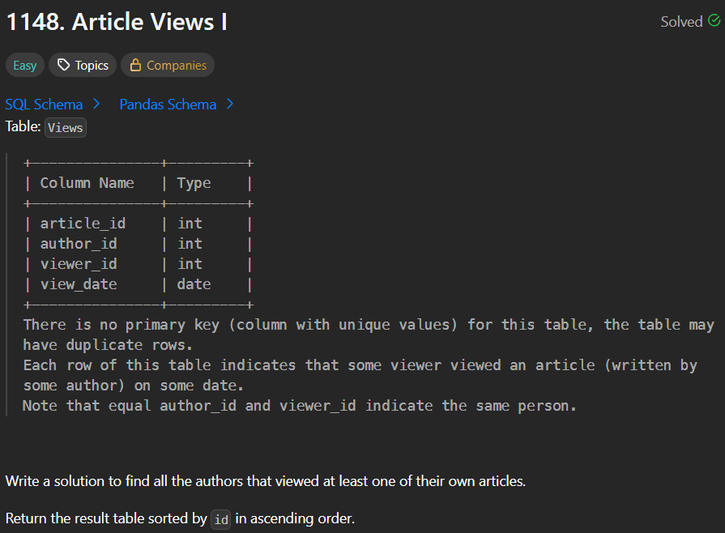

Slide 3
The query selects all distinct authors whose author_id is the same as their viewer_id, meaning they viewed at least one of their own articles.
Using DISTINCT removes duplicates so each author appears only once.
Finally, results are sorted by id in ascending order for clarity.

Slide 4
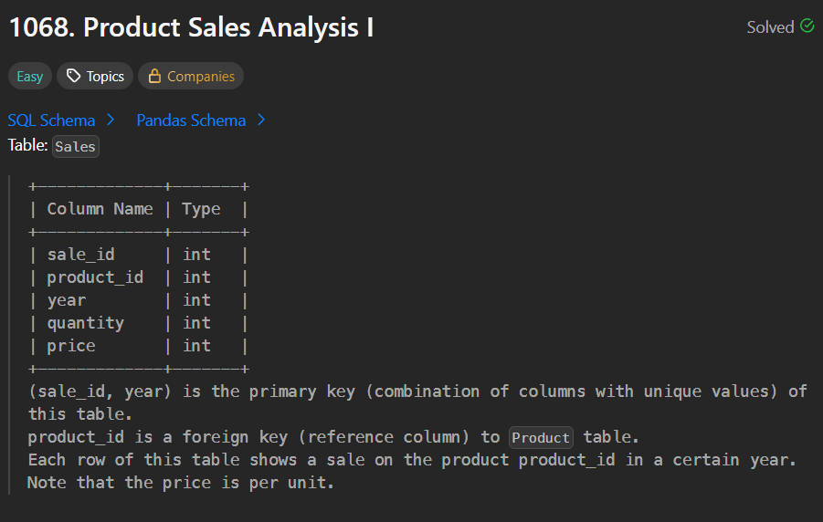
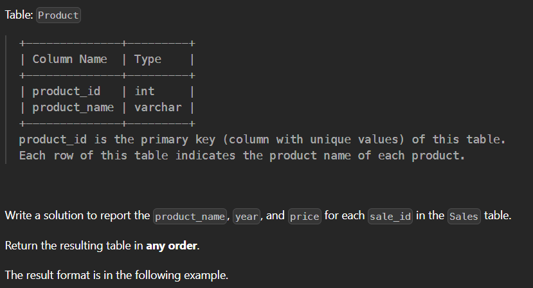

Slide 5
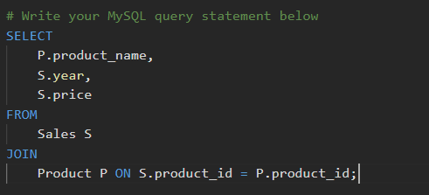
The query retrieves the product name, year, and price of each sale.
It joins the Sales table with the Product table using the common column product_id to match sales data with product details.
This helps display readable product information along with its sales records.

Slide 6
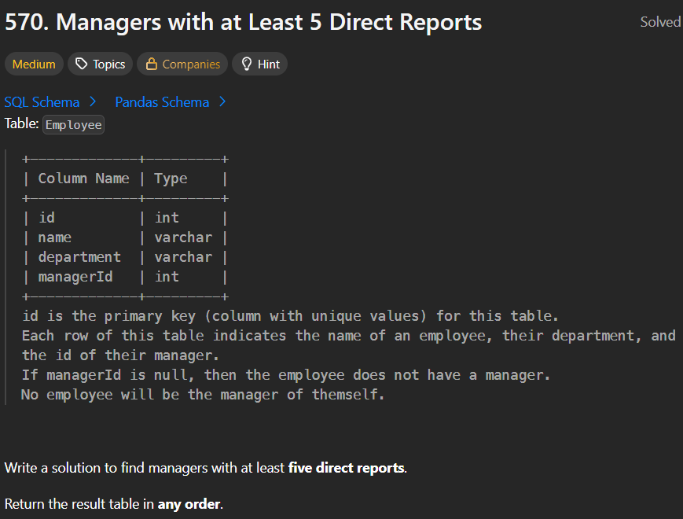

Slide 7
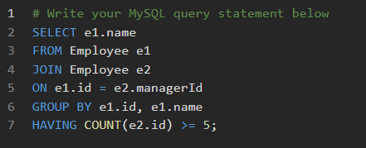
This SQL query finds managers who have at least five direct reports.
It joins the Employee table to itself — e1 represents managers and e2 represents their direct reports — using e1.id = e2.managerId.
Then, it groups results by each manager’s ID and name, and uses HAVING COUNT(e2.id) >= 5 to filter only those managers who supervise five or more employees.
Finally, it selects and displays the names of such managers.

Slide 8
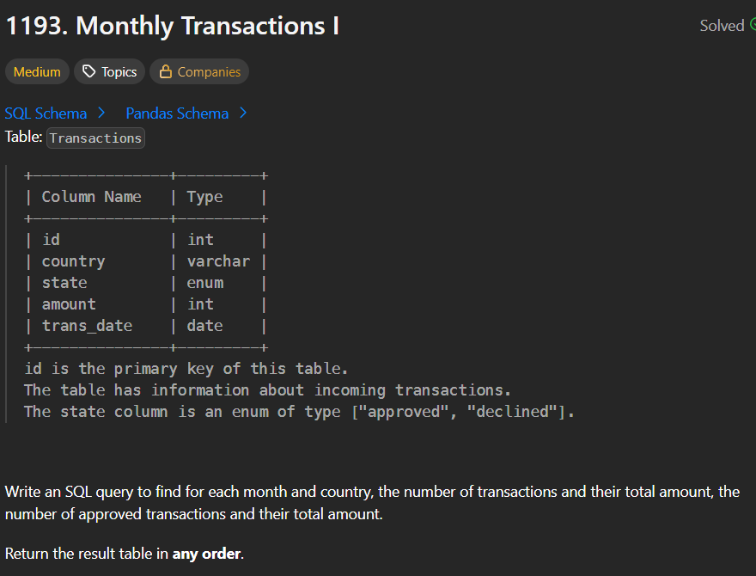

Slide 9
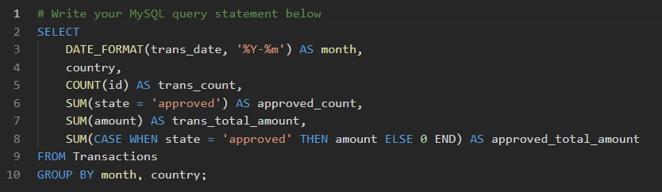
This MySQL query calculates key transaction metrics grouped by month and country.
It uses DATE_FORMAT(trans_date, '%Y-%m') to extract the year and month for grouping.
COUNT(id) gets the total number of transactions (trans_count).
SUM(state = 'approved') counts the approved transactions (approved_count) because MySQL treats the boolean expression as 1 for true and 0 for false.
SUM(amount) and a CASE statement calculate the total amount and the total approved amount, respectively.

